Slide 1
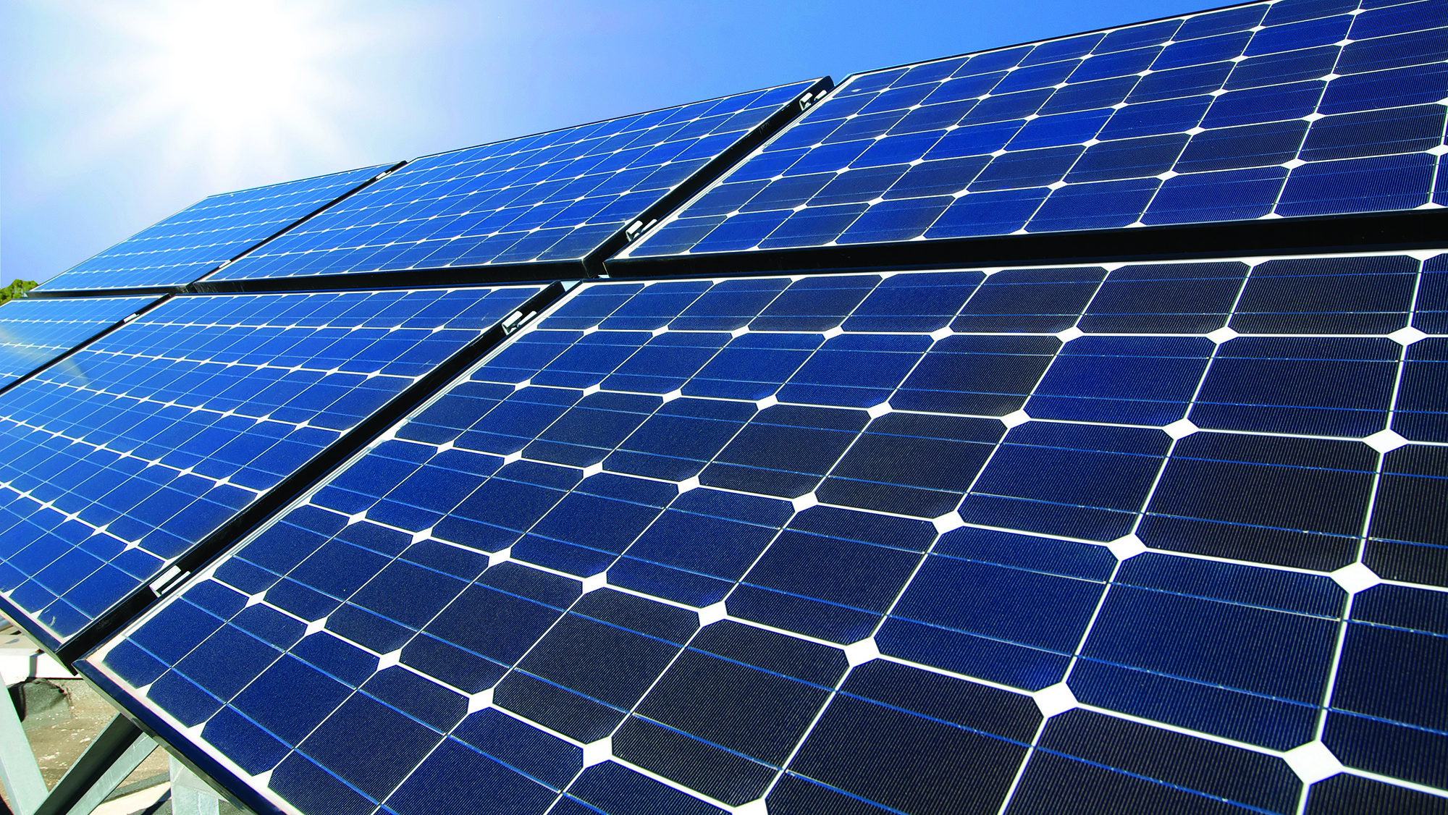
Solar Energy
The clean energy of bright future

Slide 2
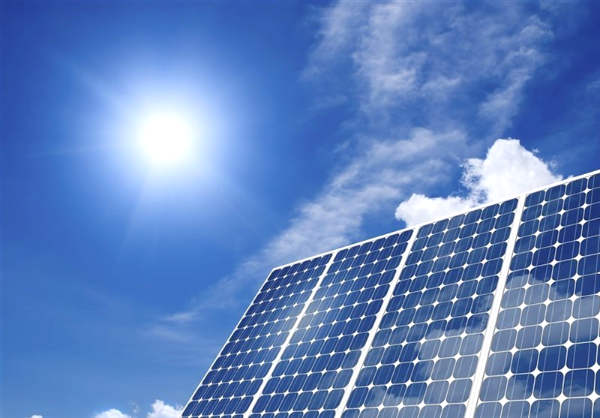
What is Solar Energy?
Solar energy means energy from the sun's rays.
It is a renewable and non-polluting energy source.
Can be used for electricity, heating, and lighting.

Slide 3
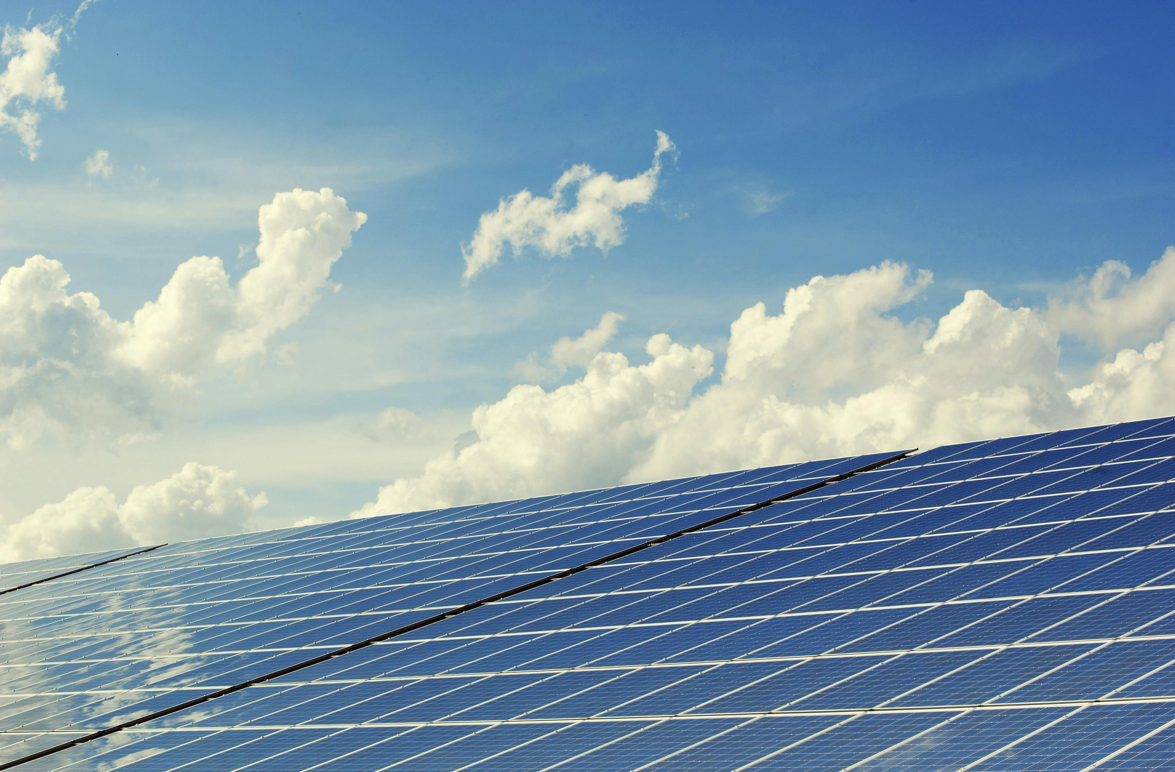
How Solar Energy Works
Sunlight is captured by solar panels.
Panels have photovoltaic (PV) cells that convert sunlight into electricity.
The electricity is stored in batteries or sent to the power grid.

Slide 4
Types of Solar Energy Systems
Solar Photovoltaic(PV): Converts sunlight into electricity.
Solar Thermal: Uses heat from sunlight to produce hot water or steam.
Concentrated Solar Power(CSP): Uses mirrors to focus sunlight for electricity generation.

Slide 5
Uses of Solar Energy
Powering homes and industries.
Street lights and traffic signals.
Solar cookers and water heaters.
Used in satellites, calculators, and watches.

Slide 6
advantages
Renewable and available everywhere.
No pollution or greenhouse gases.
Reduces electricity bills.
Low maintenance cost after installation.

Slide 7
disadvantages
Depends on weather and sunlight.
High initial installation cost.
Needs large open space for pannels.
Storage batteries are expensive.

Slide 8
Conclusion
Solar energy is clean, green, and sustainable.
Best solution for reducing pollution and saving the Earth.
Solar energy is the key to a sustainable and independent future.
By switching to solar, we protect the planet for future generations.

Slide 9
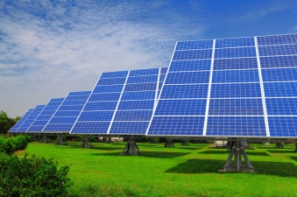
thank you
"Let's switch to solar power the future!"
.

